Slide 1


AMAZON Reviews analysis
ADSP 31013: Big Data and Cloud Computing
Vaishnavi Kokadwar
May, 2025

Slide 2

Executive Summary
The situation:
Surge in generative AI tools enables mass creation of product reviews.
Amazon’s platform faces growing volumes of suspicious or redundant review content.
Fake reviews distort product perception, mislead consumers, and erode trust.
The challenge:
Identifying and differentiating between genuine and mass-generated reviews at scale
The goal:
Investigate whether AI contributes to fraudulent or redundant reviews.
Apply big data and similarity analysis techniques to detect such patterns.
Provide insights to support automated detection and content moderation systems.

Slide 3
Data Overview
Source: This project uses the the reviews dataset from Amazon Reviews Archive stored in Google Cloud Storage (Overall Size ~ 52.4 GiB)
Structure:
Reviews Dataset
ASIN and Parent ASIN
Ratings and Helpful Vote
Text and Title of Reviews
User ID
Product Metadata
Category – Main and subcategories
Product and Store Information
Price
Number of ratings and average rating

Slide 4
Data Preparation
Loading :
Parquet files loaded into Spark DataFrame
Preprocessing/Cleaning:
Format Realignment:
Changed format of timestamp to Pandas datetime object
Changed format of price from string to long
Flattened the nested metadata for easier processing
Null Checks:
Removed columns like author information considering 99% null values
Removed rows with null values in categories and main categories
Imputations:
Imputed blank price rows with average of their respective categories
Outlier Removal:
Removed reviews by authors who have unusually high number of reviews
Business Checks:
Only include reviews of products which have valid ASINs in the metadata
Removed reviews from authors with unverified purchases

Slide 5
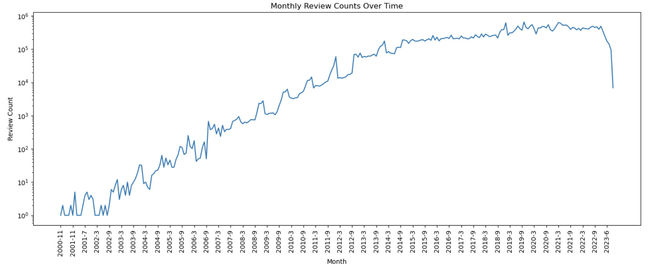
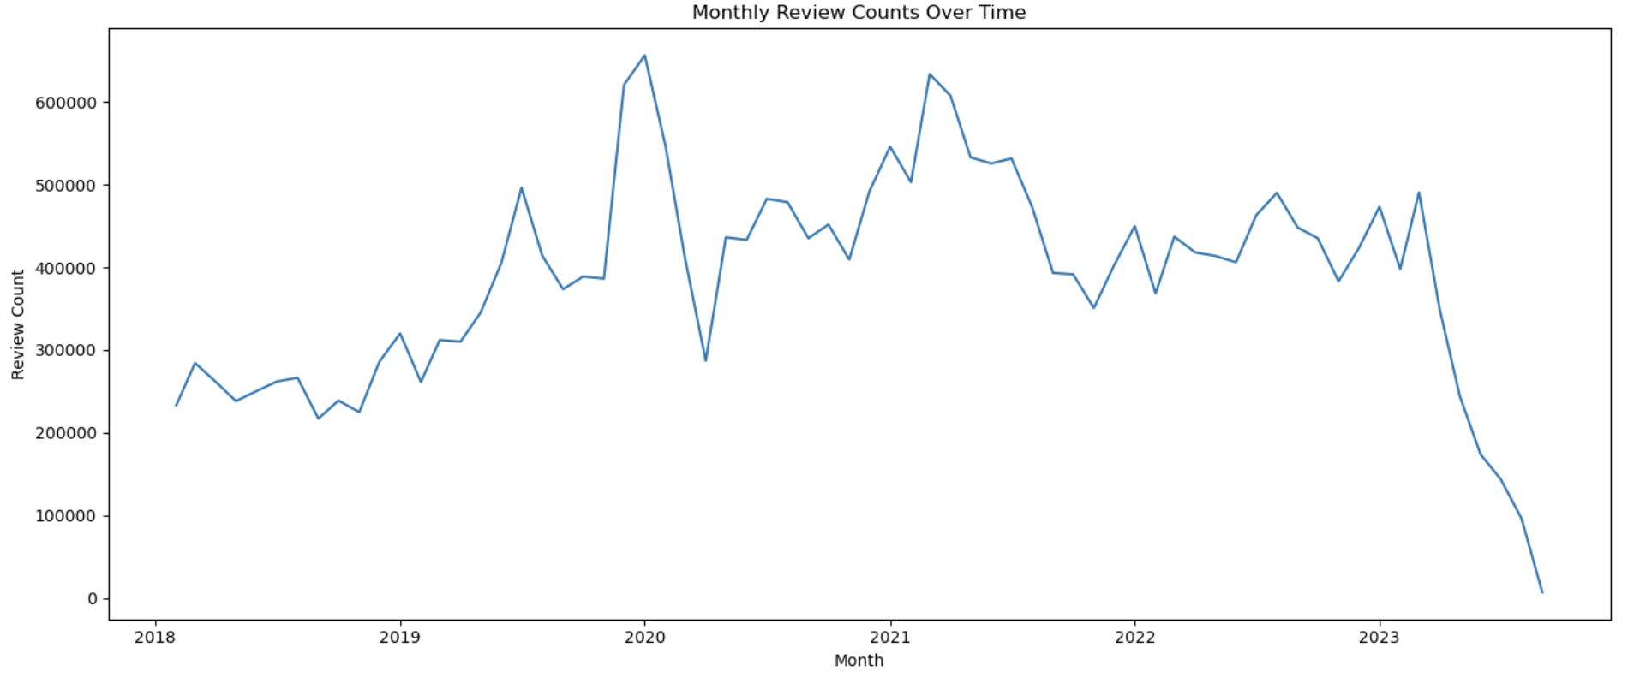
Exploratory Data Analysis
Key Insights:
The review counts has been steadily increasing since 2002
We see a drop towards the end of our timeline, this could be because all the data hasn’t been collected yet
Key Insights:
For the recent years (from 2018), the review volumes have been fairly consistent
Some peaks observed during end of the year considering increased number of purchases through the holiday season
We also observe an all-time peak during 2020-2021 which could be the effect of Covid-19 and increase in online purchases

Slide 6
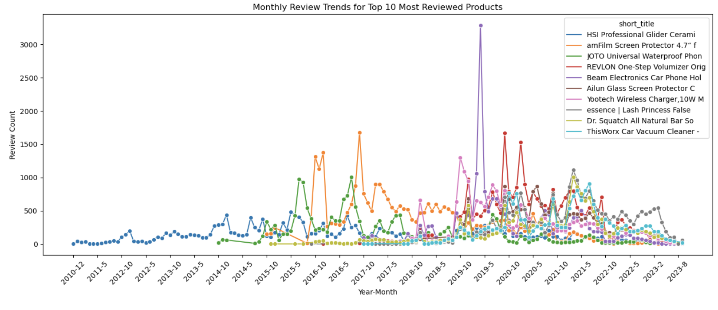
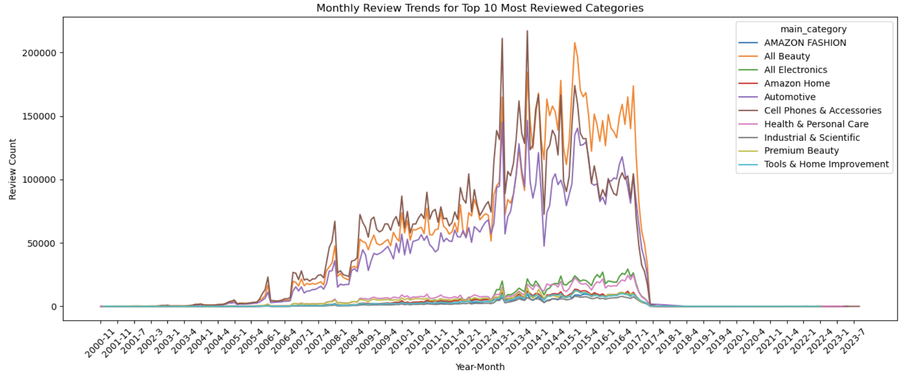
Exploratory Data Analysis
Key Insights:
The review volume across top products have been fairly stable with some peaks during some months of the year
Some products like “Beam Electronics Car Phone Holder” has unusually high reviews
These products should be checked for duplicates more carefully
Key Insights:
Three product categories, All Beauty, Cell Phone and Accessories and Automotive have the highest number of reviews all across timeline
There is a higher chance of duplicates being present for these categories

Slide 7
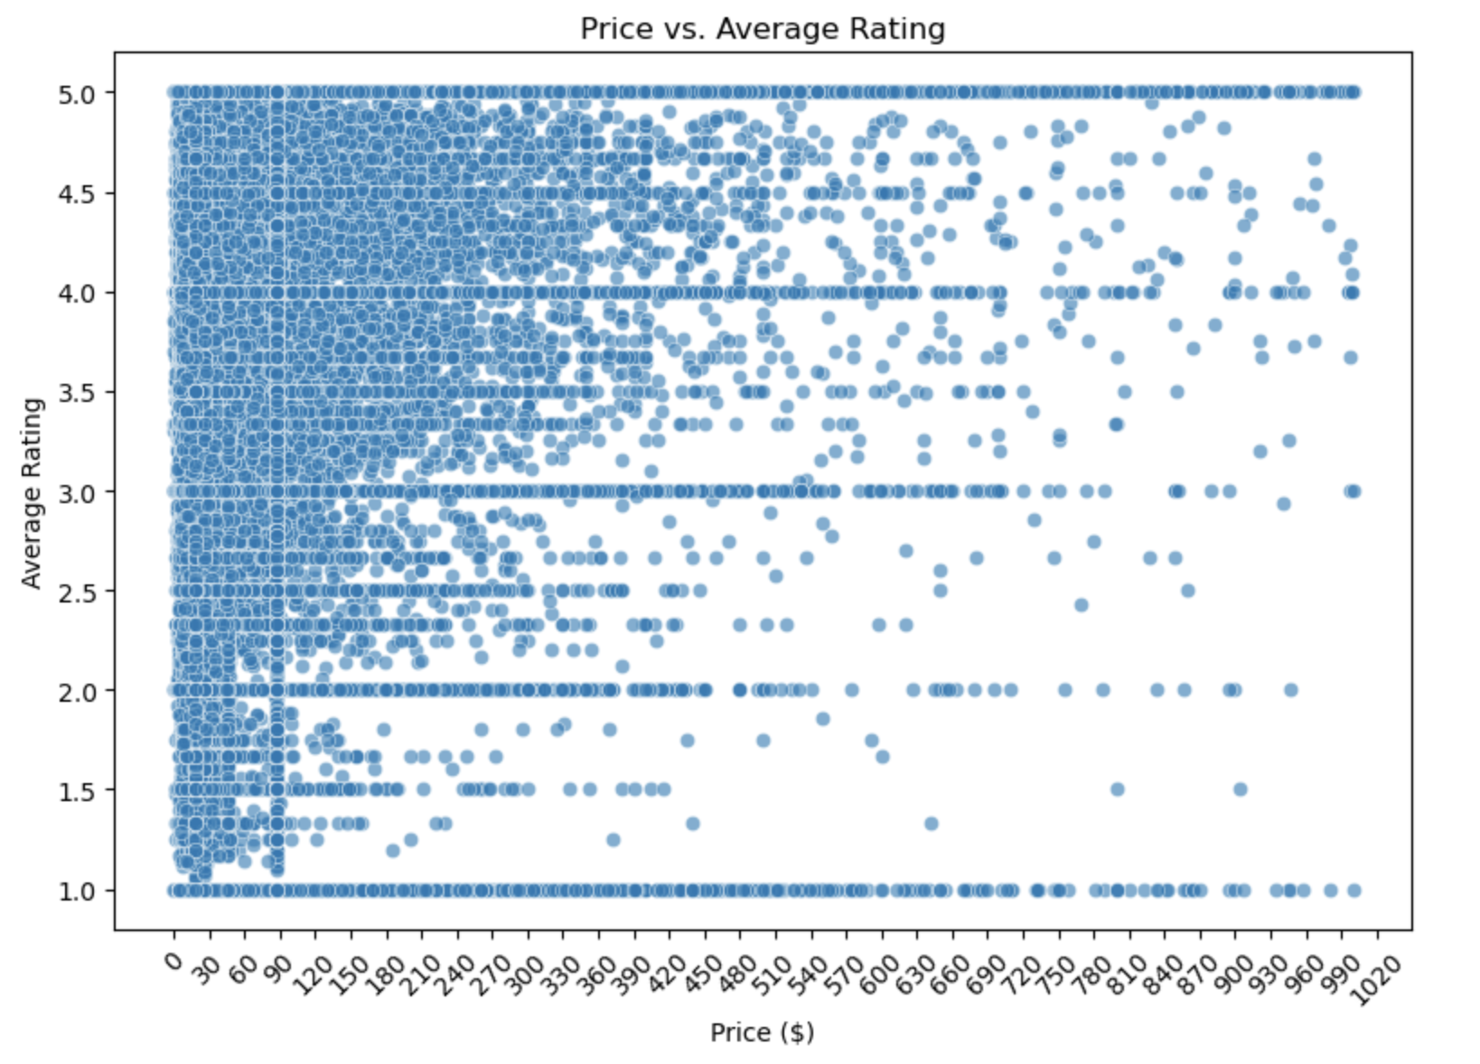
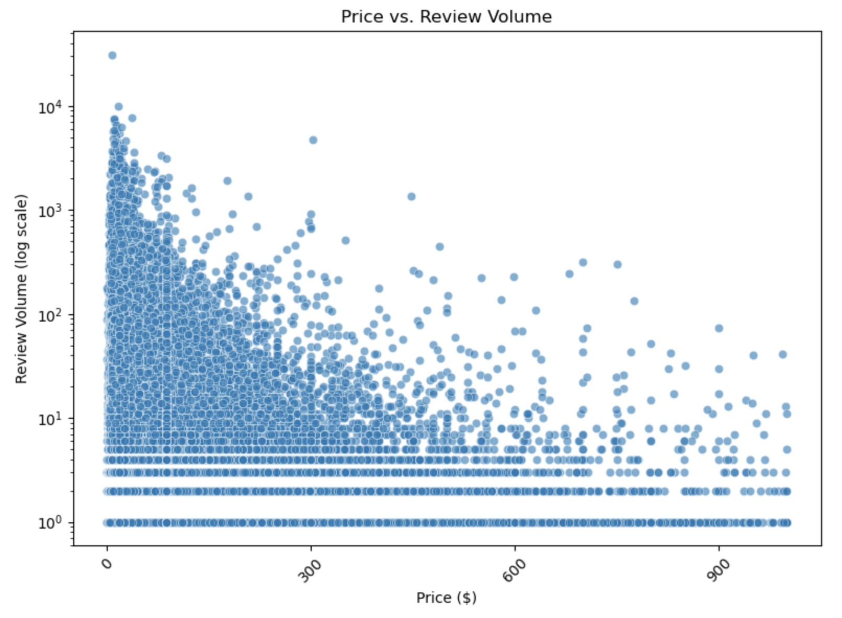
Exploratory Data Analysis
Key Insights:
For lower priced products, the variance in average rating is higher, this variance decreases as price increases. For example, a product priced $30 has ratings ranging from 0 to 5 which is not the case for a product priced $900
As for the the number of reviews, as the price increases the volume of reviews decrease.
One of the reasons for both observations could be that the number of customer purchases are higher for lower prices

Slide 8
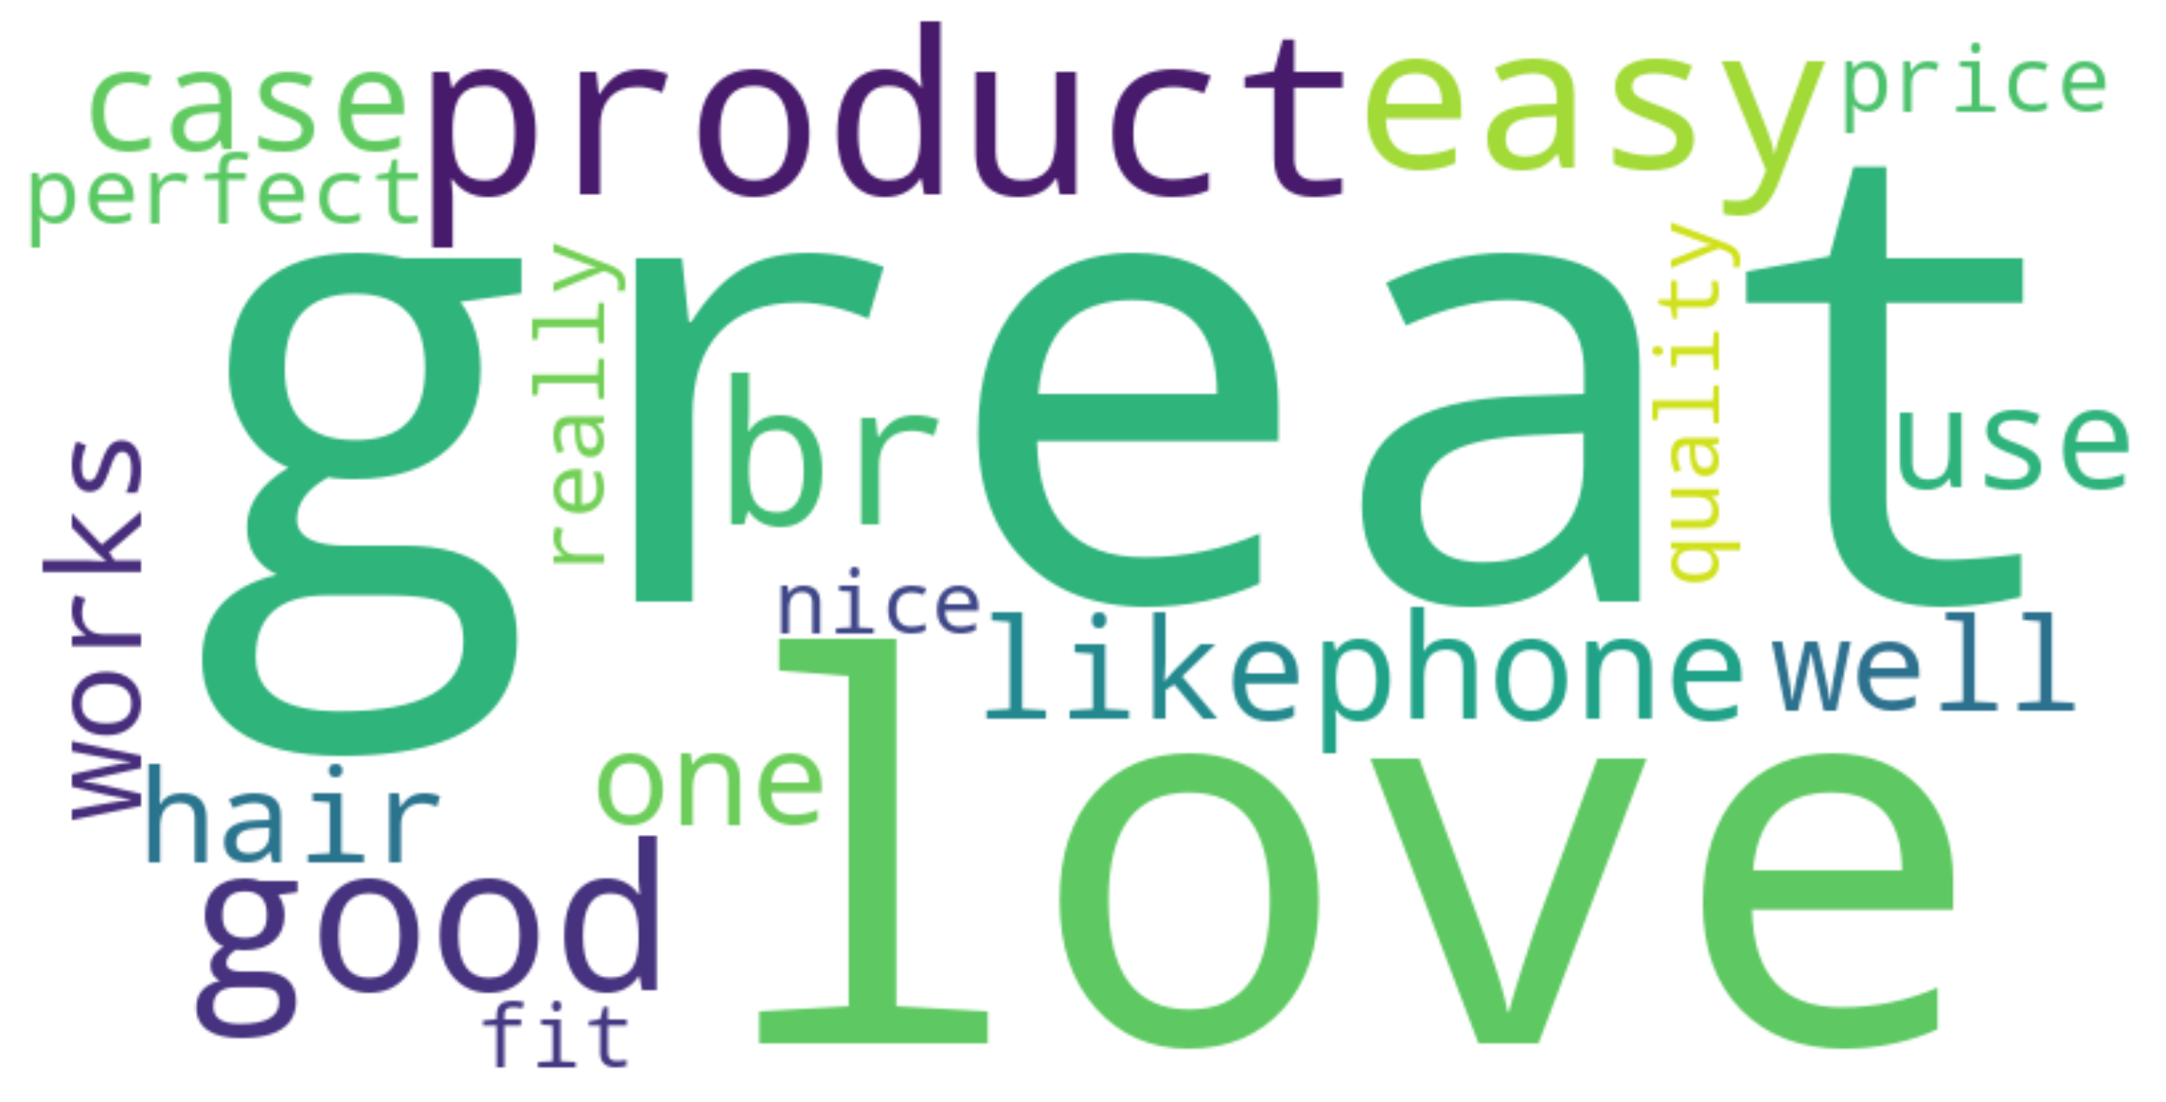
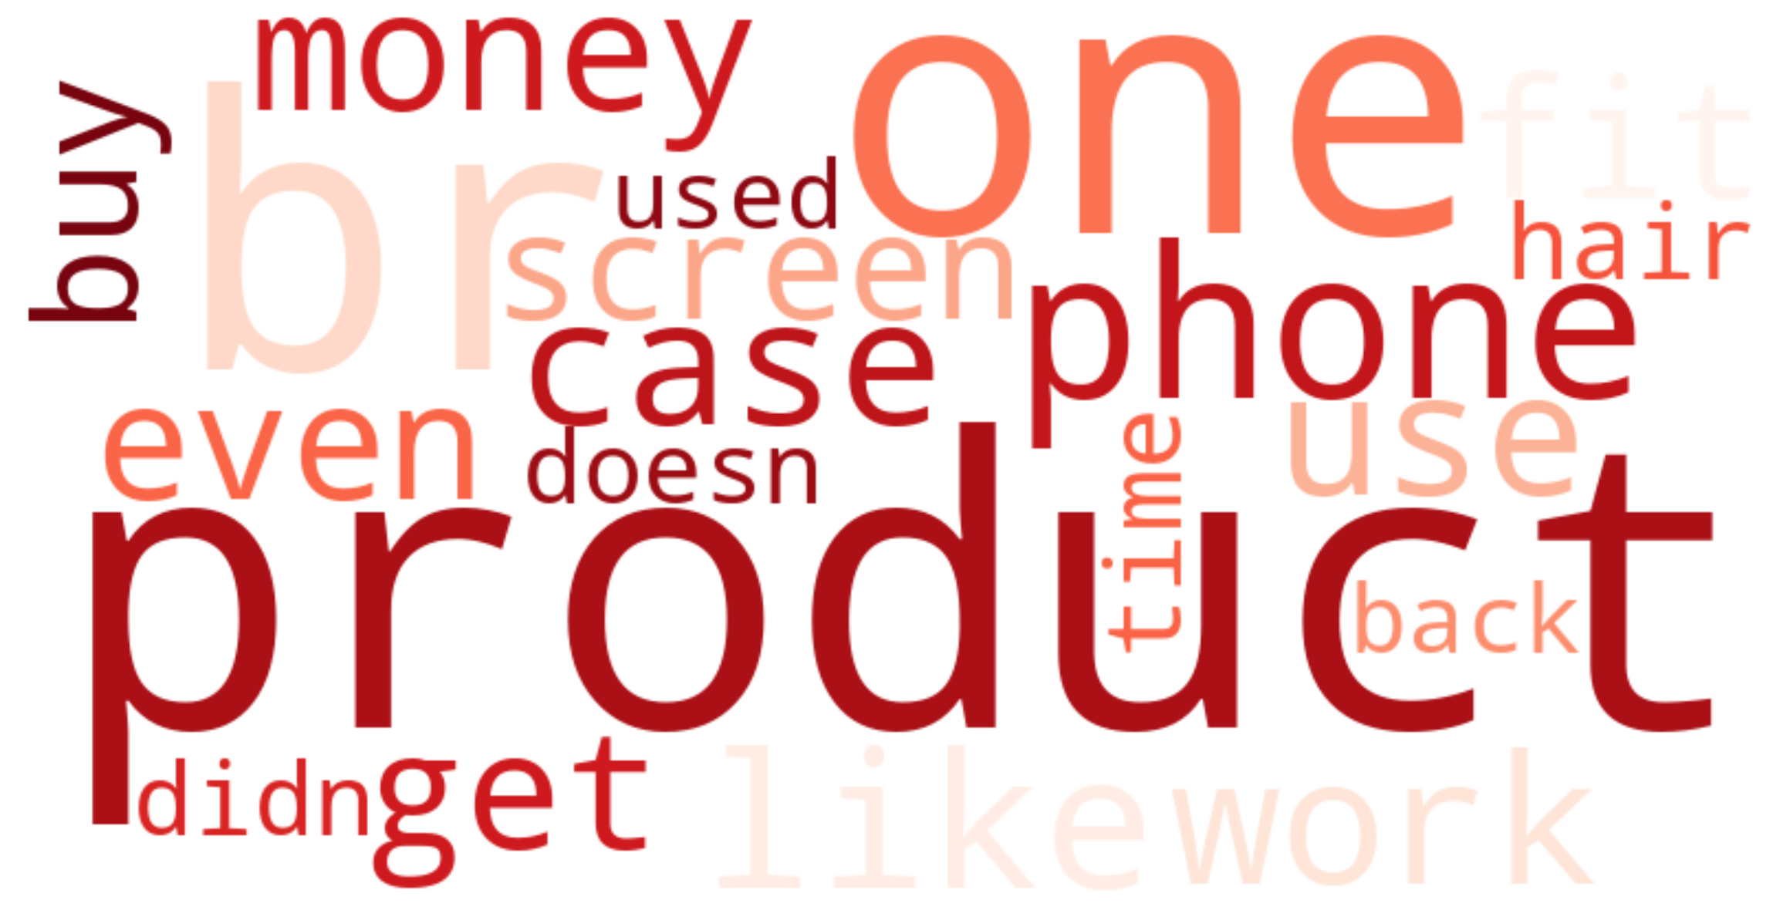
Exploratory Data Analysis
Common Words for Reviews with High Rating
Common Words for Reviews with Low Rating
Key Insights:
Good reviews have more indicative words than the bad reviews.
One common point of judgement for the customers seems to be the price of the product, although used in different sentiments (being or not being money’s worth)

Slide 9
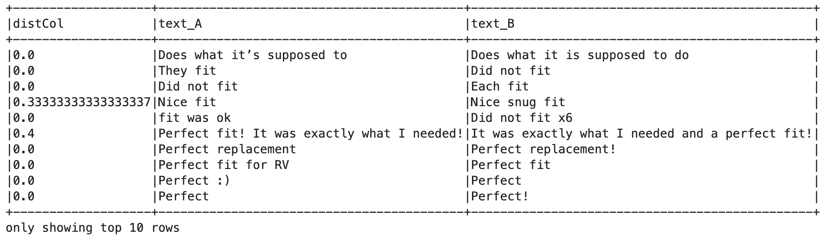
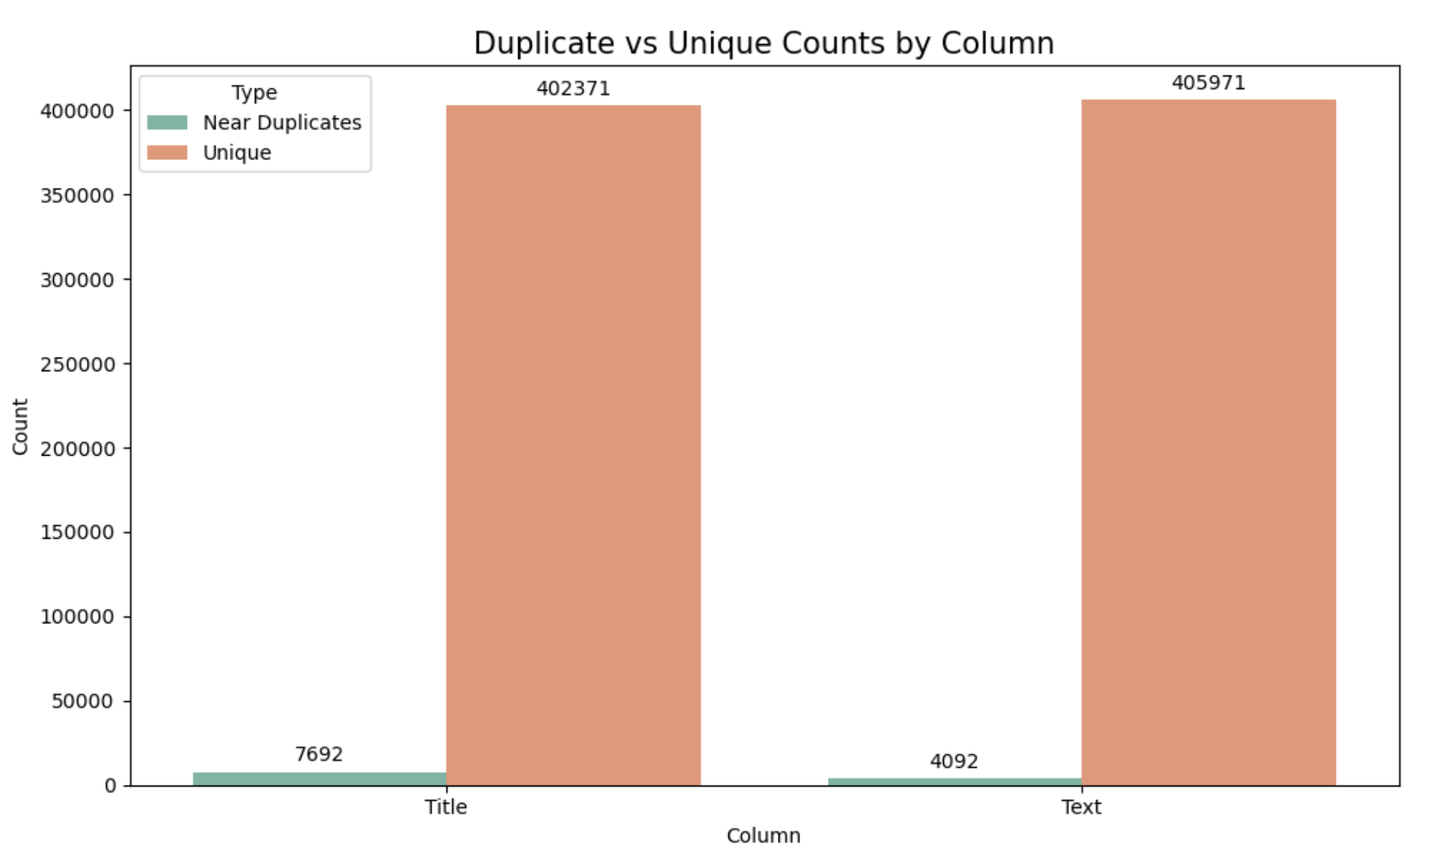
Similarity Analysis for Industrial Products
Example Duplicate Reviews for Industrial Products
Jaccard Distance = 0.5
Jaccard distance chosen as 0.5 for further analysis to ensure we don’t miss these duplicates
Methodology:
Only retained the columns of text and title from the reviews dataset
Empty vectors filtered out before fitting Hash function to avoid errors
Sampled dataset for computational efficiency and error management
Analysis done using MinHash LSH technique with various Jaccard similarities

Slide 10
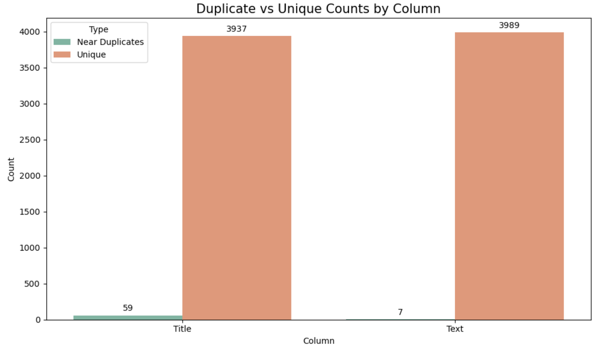
Similarity Analysis for Top Products
Methodology:
Same methodology applied for individual product reviews
Top products identified based on review volumes within the Industrial and Scientific category
Analysis for EPAuto Waterproof Car Trash Can:
Jaccard distance is set to 0.5
1.47% titles are duplicate while 0.17% reviews are found to be duplicate
Percentage of duplicates extremely small even though Jaccard distance is high
Similar results for other top 4 products found in the Industrial category

Slide 11
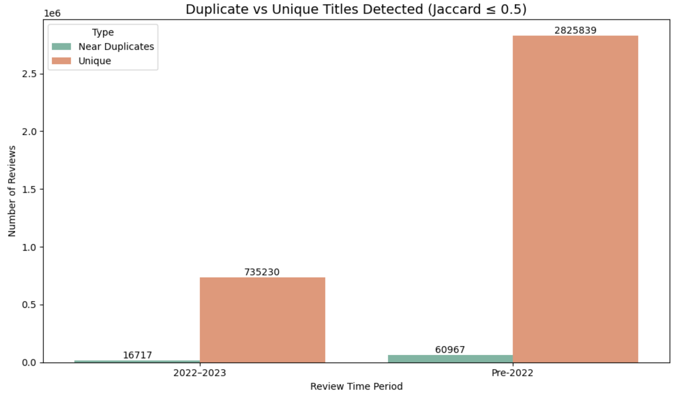
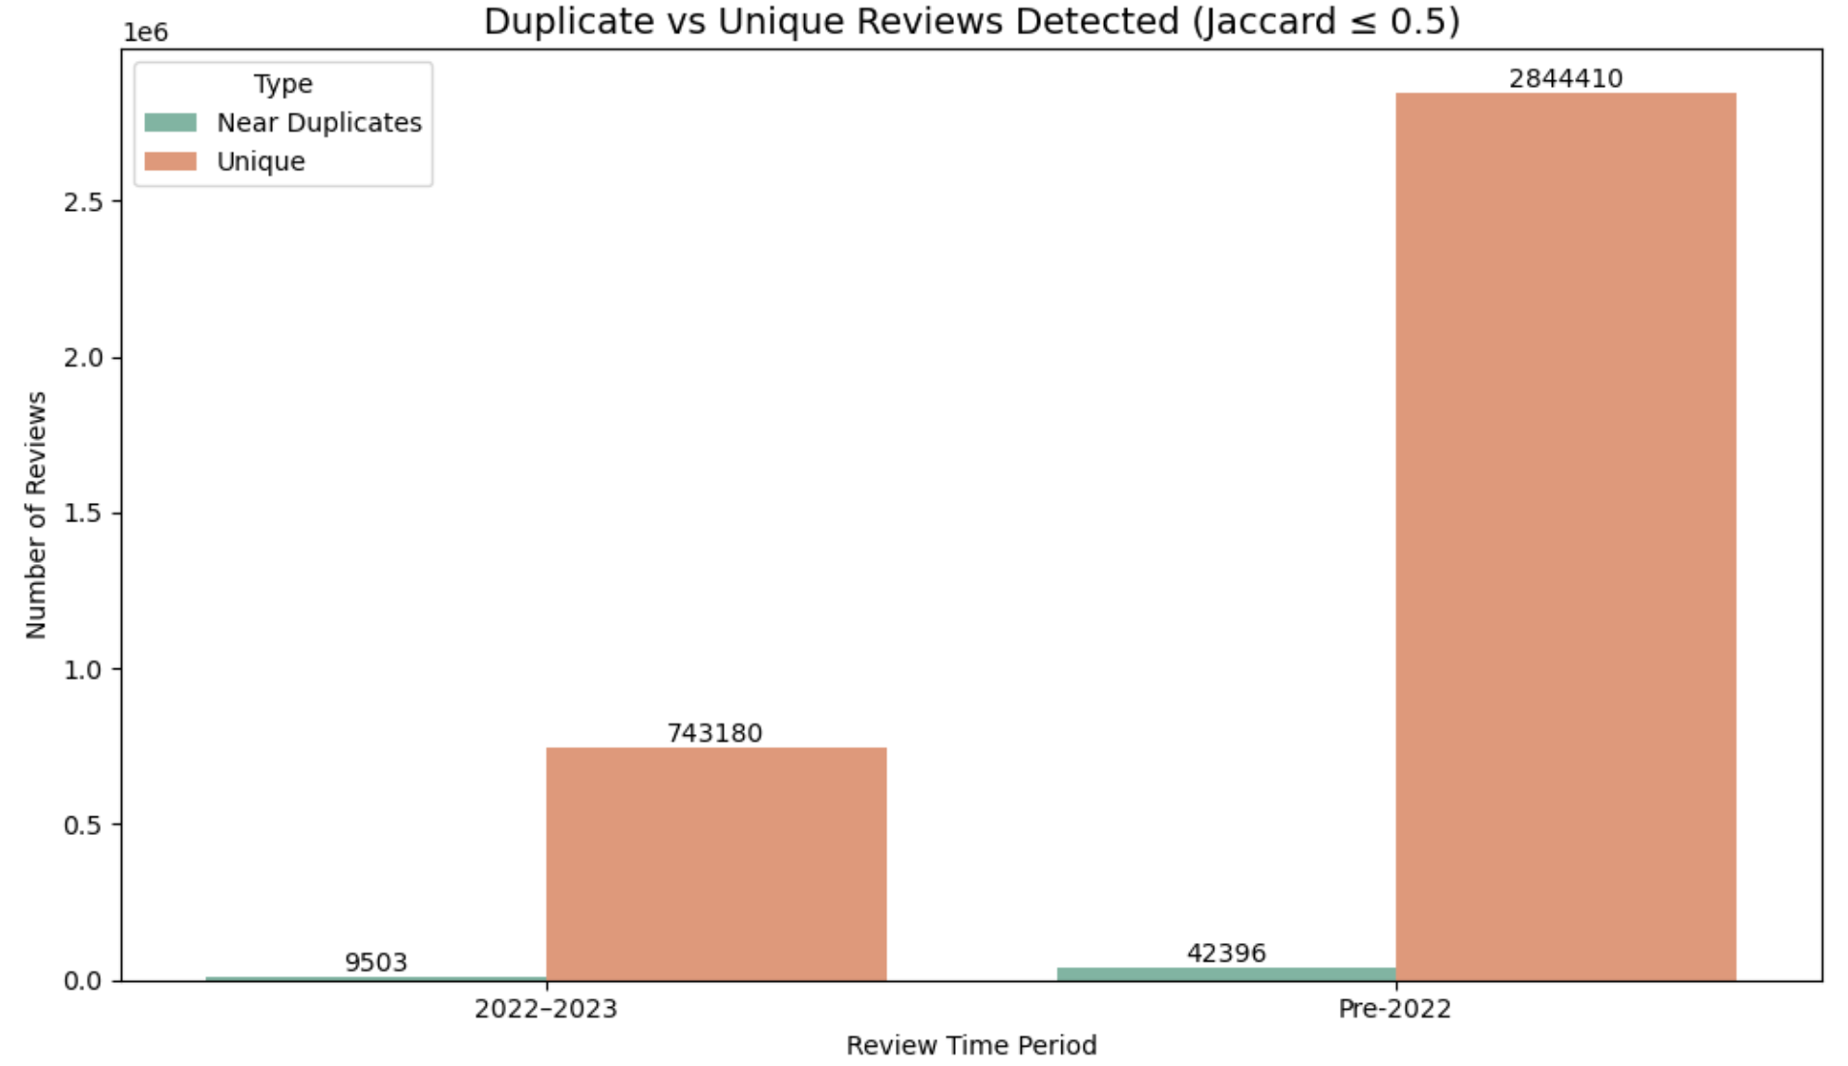
Similarity Analysis for Recent vs Old Reviews
Methodology:
Reviews data split at year 2022 mark
Same methodology applied for split review datasets
Jaccard distance set at 0.5 based on previous results
Key Insights:
Title Duplicates are 2.22% for 2022 to 2023 and 2.11% for Pre-2022
Significant difference not found for recent and non-recent duplicate percentages

Slide 12
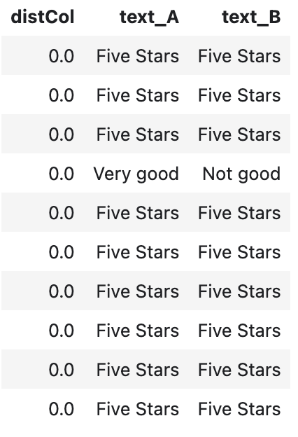
Conclusions and Recommendations
Conclusions:
A higher number of reviews does not always correlate with higher product ratings.
Top reviewers often contribute across multiple product categories — up to six on average.
Frequent word usage in reviews is not a reliable indicator of sentiment or authenticity.
Product price shows a strong correlation with both the average rating and review volume.
Reviews with high textual similarity can express contrasting sentiments (e.g., “Very good” vs. “Not good”).
Recommendations:
Avoid relying solely on review text and titles, as AI can now generate diverse and convincing fake content.
Monitor unusual reviewer behavior, such as an abnormally high number of reviews from a single user or for specific products.
Perform targeted similarity analysis on outlier reviews, especially those written by highly active users — these often show repetitive patterns.
Use Jaccard similarity to detect near-duplicate reviews effectively, ensuring semantic closeness beyond simple keyword overlap.

Slide 13
THANK
YOU

